Slide 1
Sales Prediction
Rafal Wawrzak

Slide 2
Linear Regression Model
Only one result cannot determine much from the results
Mean Absolute Error 750.8
Coefficient Determination .662

Slide 3
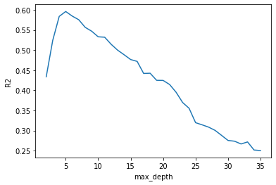
Tree Regression Model
Multiple result can Make better predictions
Mean Absolute Error 787.6
Coefficient Determination .582

